Slide 1


The Global Superstore
Global Superstore is an online retailer based in New York. It aims to be a one stop shop for its customers, hailing from 147 different countries. The customers can browse through a broad product category catalogue of more than 10,000 products. The dataset consists of 51k rows of data on purchases made around the world by the segments, consumers, corporate and home office. This large section comprises three main categories: 1. Office supplies 2. Furniture 3. Technology
Vijeta Puthran Lisa Harrell Roger Palacios

Slide 2
Agenda
Data Questions
Category Purchases
Segment Purchases
Country Purchases
Profit Contributors
Summary

Slide 3




Questions
What are people buying?
Which segments accounts for the majority of consumer purchases?
Which countries accounted for the greatest profits?
What Factors Contributed to the Profits?

Slide 4

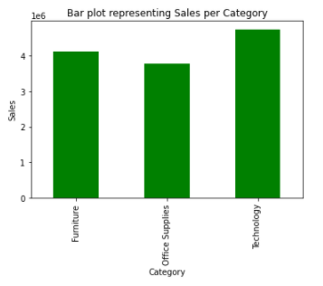


What are people buying?
Furniture
Percentage
Office Supplies
Percentage
Technology
Percentage

Slide 5
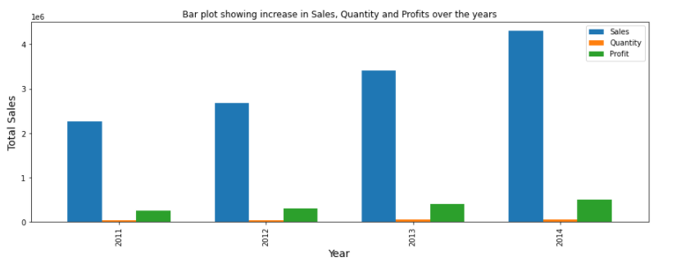
Categorical analysis using Chi-Square
Sales +90.31%
Null Hypothesis: No statistical significance exists in the distribution of the orders placed by the three segments: corporate, consumers and home office.
Profit +102.52%

Slide 6
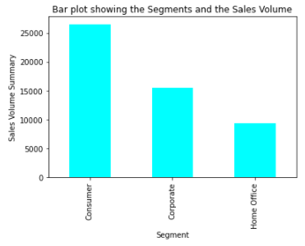



Which segment accounts for most the consumer purchases?
 | Observed | Expected
 | 26518 | 25000
 | 15429 | 25000
 | 9343 | 25000
Consumer
Corporate
Home Office
Conclusion : Since the chi-square value at a confidence level of 95% exceeds the critical value of 5.99, we conclude that the differences seen in the number of orders per segment are statistically significant.

Slide 7

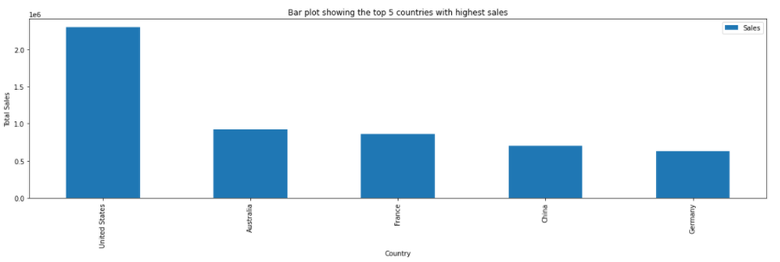
Which countries accounted for the greatest profits?
United States
Australia
France
China
Germany

Slide 8
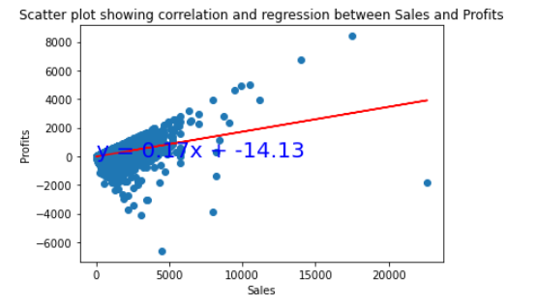
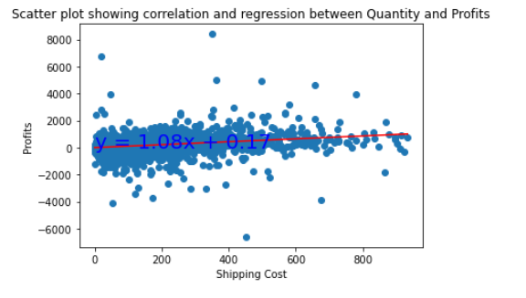


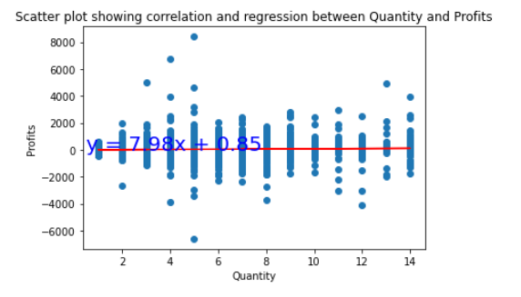
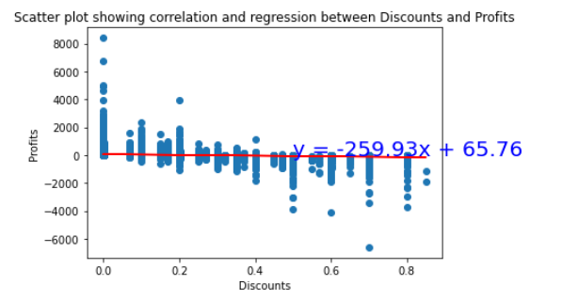


What factors contributed to the profits?
Sales
Shipping
The correlation between sales and profits is 0.48
The correlation between shipping and profits is 0.35
Quantity
Discounts
The correlation between sales and profits is 1
The correlation between discounts and profits is -0.32

Slide 9
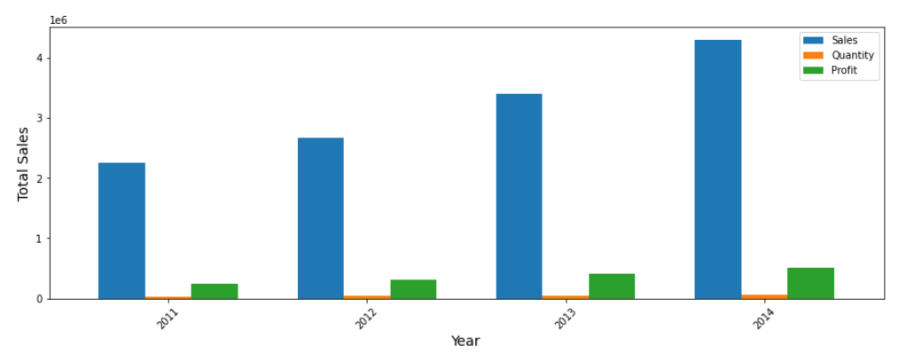
The Global superstore
Online Vendor
Technology (copiers, phones, etc.)
Furniture (chairs, tables, etc.)
Office Supplies (binders, appliances, etc.)
Sales +90.31%
Profit +102.52%

Slide 10
summary
Final Analysis

